Slide 1
App Service Web Apps

Slide 2
Agenda
Web App creation
Language Support
Deployment
Source Control Integration
Scale
Web Jobs
Site Slots
Traffic Manager
Backup
Hybrid Connections
Redis Cache

Slide 3
Fastest way to build for the cloud

Slide 4
Host your applications on Azure
The three ways to host your applications on the Microsoft Azure Platform
Infrastructure as a Service
IaaS
Platform as a Service
PaaS
Notes:
Making the point that Virtual Machines is IaaS while both CloudServices and Websites are PaaS.

Slide 5
Demo: Web App Creation

Slide 6

Develop apps with…
.NET
Python
Node.js
Java
PHP
Web App

Slide 7
Demo: Language Support

Slide 8
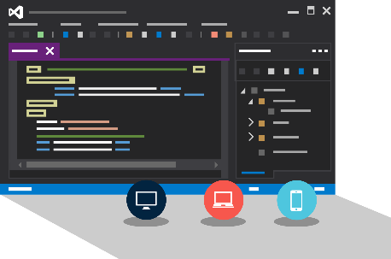
Visual Studio + App Service Web Apps
Create Azure Resources during File / New
Create Web App during deploy
Manage with Server Explorer

Slide 9
Demo: Visual Studio Support
Notes:
File / New Web Application
Show Host In The Cloud dialog
Select Empty web site (for quick create)
Right-click project, select Publish
Show Web App creation
Cancel publish
Show Web App in Server Explorer
Right-click one Web App and show settings

Slide 10

Continuous Deployment
Production Slot
Agility through Continuous Deployment
Auto-Swap
Hooks
Git pull
Commits
Changes
Staging Slot
Source Control / Code Repo
Developer

Slide 11

Source Control
Git
Visual Studio
Online
CodePlex
GitHub
BitBucket
DropBox
FTP
Choose your own adventure!
Notes:
Slide Objectives:
Objective #1
Transition:
Transition statement(s) to setup the slide
Speaking Points:
Speaking Point #1
Speaking Point #2
Notes:
Any notes go here

Slide 12
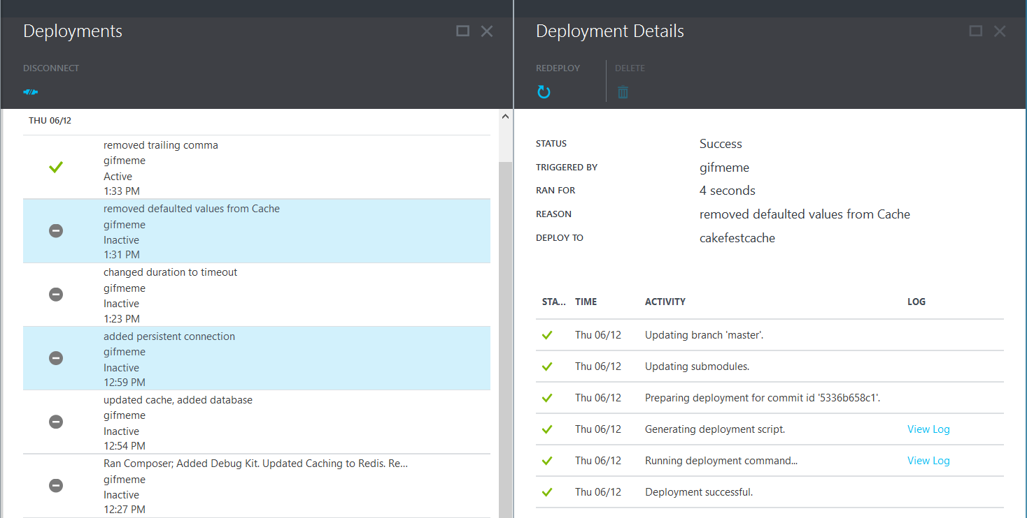
Deployments

Slide 13
Scale

Slide 14
Manual Scaling
Instance Count
1
6
Instances

Slide 15
AutoScale
Web App

Slide 16
AutoScale
Web App

Slide 17
AutoScale
Web App

Slide 18
Auto-Scaling (Metrics)
Instance Count
2
6
Instances
[Metric]
60
80
Percent
CPU Percentage
Memory Percentage
Disk Queue Length
HTTP Queue Length
Data In
Data Out

Slide 19
AutoScale
Rule
Web App
CPU: 40%
Notes:
You will illustrate an AutoScale rule of a Web App.
Speaker notes.
You will be explaining autoscale rule example with CPU as the metric, threshold greater 70% and Duration time of 15 minutes before the first autoscale action is performed. This example rule has a Cool down time of 15 minutes before next autoscale action is performed if the usage of the CPU continues to be above the threshold value. Autoscale Action will increase number of instances for the Web App by 1 in this example.
The AutoScale rule is best demonstrated by following this sequence of transitions.
Show traffic increase <click>
Show CPU usage spike above 70% <click>
Show with timer 15 minutes of Duration<click>
Show a new instance of Web App is being provisioned <click>
Show with timer 15 minutes of Cool down time <click>
Show another instance of Web App being provisioned<click>

Slide 20
AutoScale
Rule
Web App
CPU: 40%
Duration
CPU: 70%-90%
Cool down

Slide 21
Demo: Manual/Auto Scale

Slide 22
Auto-Scale Considerations
Only Scales the Web Tier
Scale Up/Down is not instantaneous

Slide 23
Deployment Slots

Slide 24
One Web App. Multiple deployments.
Web App
Production
slot
swap
Staging slot
Streamline dev, test and production deployment workflow Swap staging and production with zero downtime Instantaneous rollback to previous “last known good site”
Enables A/B testing, continuous deployment, staged publishing and much more
Web App

Slide 25
Staging
Web App

Slide 26
Demo: Set up staging environments
Notes:
http://azure.microsoft.com/en-us/documentation/articles/web-sites-staged-publishing/

Slide 27




Application Settings
Set Application Settings via Azure portal or PowerShell
Set key/value
In Web.Config
Runtime
Intercept
Retrieve Application
Settings
Web Deployment Package
Source Control
Code Repo
Microsoft Azure
Notes:
Slide objective:
How Application Strings and Connection Strings Work in Web Apps
Speaker notes:
Visit here for more info http://azure.microsoft.com/blog/2013/07/17/windows-azure-web-sites-how-application-strings-and-connection-strings-work/

Slide 28
Web Jobs

Slide 29






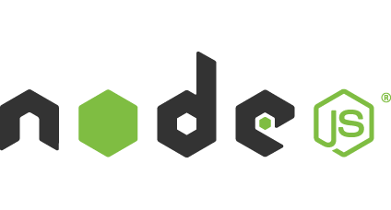

Light-weight CPU Intensive Tasks
run.cmd, run.bat
run.exe
run.ps1
run.sh
run.php
run.py
run.js
Job Type:
On-Demand, Scheduled, Continuous
Scale:
Singleton, Multi-instance
WebJobs SDK Feature:
BlobTrigger, TableTrigger, QueueTrigger, ServicebusTrigger
Deployment:
Portal, Visual Studio, CLI, Git

Slide 30
WebJobs
Web App

Slide 31
WebJobs
Web App

Slide 32
Demo: WebJobs

Slide 33
App Service Environment

Slide 34
App Service Environment (ASE)
New Premium Tier Feature
Dedicated compute resources and network resources
Increased Scaling Options
Directly created in a Virtual Network
Support all Web App features and capabilities
Support Web, Mobile and API Apps
Global Scale

Slide 35
Conceptual Model
App Service Plan
App Service Plan
App Service App
App Service App
App Service App
App Service App
App Service App
App Service App
SKU: Premium (# of sites, storage, slots…)
Compute Resource: P4 ( 8 cores, 14 GB memory)
Scale: 8
SKU: # of sites, storage, slots…
Compute Resource: cores, memory
Scale: number of instances
Note: For App Service Environment the SKU will always be Premium
Notes:
Speaker notes:
Explain how ASE differ from multi-tenant App Service using App Service Plan.

Slide 36
Scaling
Virtual Network
App Service Environment
Worker Pool
ExtraLarge
Large
Medium
ExtraLarge
Small
Worker Pool
ExtraLarge
ExtraLarge
Worker Pool
ExtraLarge
ExtraLarge
Notes:
Speaker notes:
Explain how apps in ASE scale using worker pool.
(TBD) Add more notes.

Slide 37
Traffic Manager

Slide 38
17 regions worldwide in 2015
App Service Web App footprint

Slide 39
Intelligent customer routing with Traffic Manager
www.yourapp.com

Slide 40
www.yourapp.com

Slide 41
Backup

Slide 42
Backups
Web App Files
Web App Settings Manifest
Database (Optional)

Slide 43
Hybrid Connections

Slide 44



Hybrid Connections
Corporate Network
Microsoft SQL Server
Web App
Hybrid Connection Manager
Other published resources
Hybrid Connection
Mobile App

Slide 45
Redis Cache

Slide 46

Redis Cache
Full Functionality Redis Cache Cluster
Master/Slave Configuration
Up to 26GB
SSL Supported

Slide 47
Demo: Redis Cache

Slide 48
Stateless
Notes:
https://coderead.wordpress.com/2011/09/12/sticky-sessions-and-windows-azure
Although it is possible to use Sticky Sessions in Azure it’s not a great fit for cloud architecture, for these reasons:
1) When you provision new instances, only new sessions will be routed to them. Depending on your load balancing logic, new sessions may also still be provisioned on the old instances. This results in it taking a long time (depending on the average length of your session) for load to be evenly distributed across your instances.
2) Cloud solutions should be designed to fail. One of your instances may be removed at any time for patching, or hardware failure. With a sticky session scenario, the clients with a session on this instance will probably have to log in again, or may see an error page, depending on your load balancing logic.
3) Unless your load balancer shares state in some way, it’s likely that you’re load balancing with a single instance (single point of failure) and not eligible for the Microsoft SLA.

Slide 49
Demo: Redis Cache for ASP.NET Session state
Notes:
http://azure.microsoft.com/en-us/documentation/articles/web-sites-dotnet-session-state-caching

Slide 50
Application Insights

Slide 51
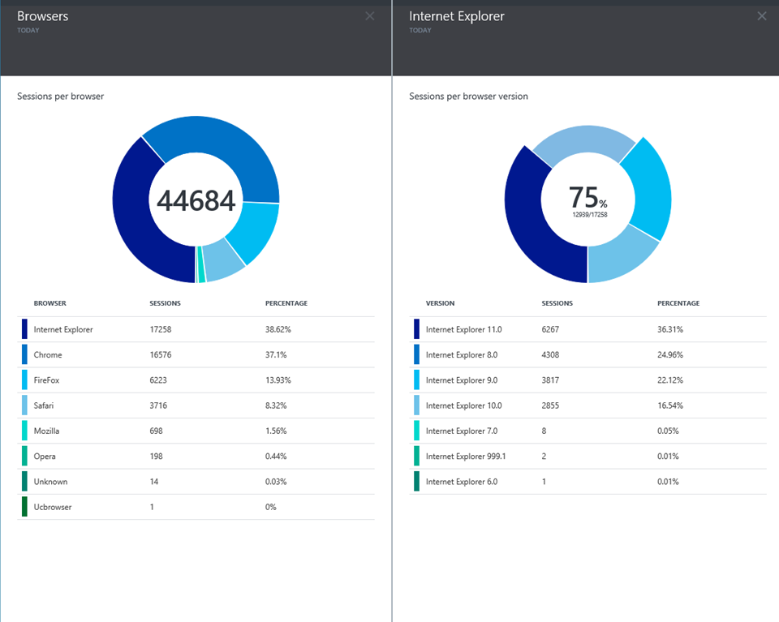
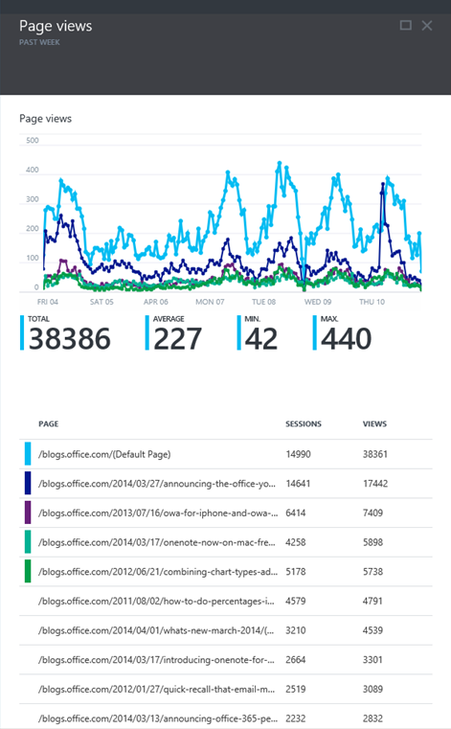
Application Insights
Application Insights

Slide 52
Try App Service: Web Apps today
https://tryappservice.azure.com
Ask Questions:
Twitter:
Email
Public forum:

Slide 53
Q&A

Slide 54


Get started
Visit azure.microsoft.com

